Slide 1
Rent vs Minimum Wage
By David Powell

Slide 2
Rent vs Minimum Wage
Talk about what minimum wage is
Show you statistics and calculations for four different cities across the country
Show how minimum wage needs to be changed/looked at across the board

Slide 3
What is Minimum Wage?
Minimum wage is defined as the minimum income necessary for a worker to meet their basic needs.
Needs are defined to include food, housing, and other essential needs such as clothing
Around 434,000 workers earned at the federal minimum wage of $7.25
About 1.3 million workers fell below the federal minimum
2.1% of all hourly paid workers make at or below minimum wage

Slide 4

Nashville, TN
Population of 691,243 as of 2017
Capital city of Tennessee
Home of the Tennessee Titans (NFL) and the Nashville Predators (NHL)
4.1% of workers earn federal minimum wage or less

Slide 5
Nashville , TN
Minimum wage last changed in 2009
Minimum wage is currently $7.25
Rent has rapidly changed over the years

Slide 6
Nashville, TN
The amount remaining after paying just your rent payment
As of 2016 you could no longer afford rent itself
Once you factor in utilities, averaged at $159 per month, the gap gets even larger

Slide 7
Nashville, TN
Living Wage as defined is a wage that is high enough to maintain a normal standard of living
Living Wage for Nashville, TN is $11.63, according to a study done by MIT
You are left with $630.88 per month after paying rent for a one-bedroom apartment
After utilities you are left with $471.56 roughly

Slide 8
Nashville, TN
Bill called Raise the Wage Act passed the house in 2019 to raise the federal minimum wage to $15 an hour
$1,170.08 left over after paying rent
$1,010.76 roughly left over after paying utilities
At the current federal minimum wage and Tennessee’s minimum wage a person would have to work 83 hours a week to meet the same amount left.

Slide 9
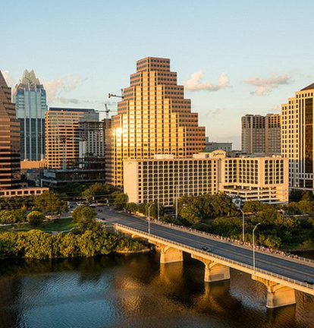
Austin, TX
Population of 950,715 as of 2017
Growing tech hub city with companies like Apple, Google, HP, 3M and others having offices there
No professional sports team but home to University of Texas Longhorns

Slide 10
Austin, TX
Minimum wage has not changed since 2009
Minimum wage is same as federal minimum wage of $7.25

Slide 11
Austin, TX
As of 2015 you could no longer afford rent payments in the Austin area
Average utility payments are roughly $139.53
A single adult cannot meet living standards

Slide 12
Austin, TX

Slide 13
Austin, TX

